Slide 1
SAMPLING AND SAMPLING DISTRIBUTION OF SAMPLE MEAN

Slide 2
Objectives:
After a successful completion of this unit, students will be able to:
Differentiate the two major sampling techniques: probabilistic and non-probabilistic
Apply simple random sampling technique to select sample
Define sampling distribution of the sample mean

Slide 3
Methods of sampling
Definition of some basic terms
Sampling: is the technique of selecting representative sample from the whole.
Population: is the totality of elements or units under study.
Sample: is the part of the population.
Sampling Frame: A complete list of all the units of the population is called the sampling frame.

Slide 4
A unit of population is a relative term. If all the workers in a factory make a population, then a worker is a unit of the population. If all the factories in a country are being studied for some purpose, then a factory is a unit of the population of factories. The frame provides a base for the selection of a sample.

Slide 5
Major reasons to use sampling
Saves Time and Cost: As the size of the sample is small as compared to the population, the time and cost involved on sample study are much less than the complete counts. Hence a sample study requires less time and cost.
To prevent destruction: The destructive nature of some experiments (or inspection) do not allow to carryout complete enumeration, for instance, to check quality of beers, to study the efficacy of new drugs, testing the life length of a bulb, e t c.
Sample survey provides higher level of accuracy: This accuracy can be achieved through more selective recruiting of interviewers and supervisors, more extensive training programs, a closer supervision of the personnel involved and a more efficient monitoring of the field work.

Slide 6
Types of sampling
Generally, two types of sampling methods exist:
probability and
non-probability sampling.

Slide 7
Probability Sampling
The term probability sampling (or random sampling) is used when the selection of the sample is purely based on chance.
There is no subjective bias in the selection of units. Every unit of the population has a known nonzero probability to be in the sample.
The following are some of the random sampling methods: Simple random sampling, Stratified random sampling, Cluster sampling, Systematic random sampling.

Slide 8
Simple random sampling
Simple random sampling is a method of selecting a sample from a population in such a way that every unit of the population is given an equal chance of being selected.
In practice, you can draw a simple random sample of elements using either the 'lottery method' or 'tables of random numbers'.

Slide 9
Cont…
For example, you may use the lottery method to draw a random sample by using a set of 'N' tickets, with numbers ' 1 to N' if there are 'N' units in the population. After shuffling the tickets thoroughly, the sample of a required size, say n, is selected by picking the required n number of tickets.

Slide 10
Cont…
The best method of drawing a simple random sample is to use a table of random numbers. After assigning consecutive numbers to the units of population, the researcher starts at any point on the table of random numbers and reads the consecutive numbers in any direction horizontally, vertically or diagonally. If the read out numbers corresponds with the one written on a unit card, then that unit is chosen for the sample.

Slide 11
Suppose that a sample of 6 study centers is to be selected at random from a serially numbered population of 60 study centers.
The following table is portion of a random numbers table used to select a sample.

Slide 12
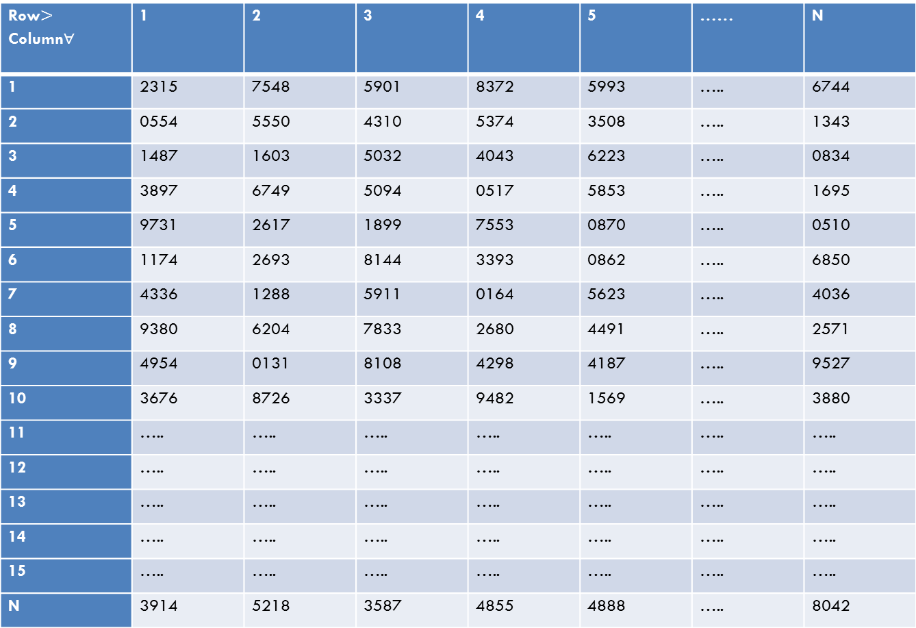
Row$>$ Column$∀$ | 1 | 2 | 3 | 4 | 5 | …… | N
1 | 2315 | 7548 | 5901 | 8372 | 5993 | ….. | 6744
2 | 0554 | 5550 | 4310 | 5374 | 3508 | ….. | 1343
3 | 1487 | 1603 | 5032 | 4043 | 6223 | ….. | 0834
4 | 3897 | 6749 | 5094 | 0517 | 5853 | ….. | 1695
5 | 9731 | 2617 | 1899 | 7553 | 0870 | ….. | 0510
6 | 1174 | 2693 | 8144 | 3393 | 0862 | ….. | 6850
7 | 4336 | 1288 | 5911 | 0164 | 5623 | ….. | 4036
8 | 9380 | 6204 | 7833 | 2680 | 4491 | ….. | 2571
9 | 4954 | 0131 | 8108 | 4298 | 4187 | ….. | 9527
10 | 3676 | 8726 | 3337 | 9482 | 1569 | ….. | 3880
11 | ….. | ….. | ….. | ….. | ….. | ….. | …..
12 | ….. | ….. | ….. | ….. | ….. | ….. | …..
13 | ….. | ….. | ….. | ….. | ….. | ….. | …..
14 | ….. | ….. | ….. | ….. | ….. | ….. | …..
15 | ….. | ….. | ….. | ….. | ….. | ….. | …..
N | 3914 | 5218 | 3587 | 4855 | 4888 | ….. | 8042

Slide 13
If you start in the first row and first column, centers numbered 23, 05, 14,…, will be selected. However, centers numbered above the population size (60) will not be included in the sample. In addition, if any number is repeated in the table, it may be substituted by the next number from the same column.

Slide 14
1, the number to start with is 83. In this way you can select first 6 numbers from this column starting with 83.
The sample, then, is as follows:
83 75
53 33
40 01
05 26
Hence, the study centers numbered 53, 40, 05, 33, 01 and 26 will be in the sample.

Slide 15
Simple random sampling ensures the best results. However, from a practical point of view, a list of all the units of a population is not possible to obtain.
Even if it is possible, it may involve a very high cost which a researcher or an organization may not be able to afford. In addition, it may result an unrepresentative sample by chance.

Slide 16
Stratified sampling
Stratified random sampling takes into account the stratification of the main population into a number of sub-populations, each of which is homogeneous with respect to one or more characteristic(s).
Having ensured this stratification, it provides for selecting randomly the required number of units from each sub-population.
The selection of a sample from each subpopulation may be done using simple random sampling. It is useful in providing more accurate results than simple random sampling.

Slide 17
Systematic sampling
In this method, samples are selected at equal intervals from the listings of the elements.
This method provides a sample as good as a simple random sample and is comparatively easier to draw a sample.
For instance, to study the average monthly expenditure of households in a city, you may randomly select every fourth households from the household listings

Slide 18
Cluster sampling
Cluster sampling is used when sampling frame is difficult to construct or using other sampling techniques (simple random sampling) is not feasible or costly.
For instance, when the geographic distribution of units is scattered it is difficult to apply simple random sampling.
It involves division of the population of elementary units into groups or clusters that serve as primary sampling units.
A selection of the clusters is then made to form the sample.
The precision of estimates made based on samples taken using this method is relatively low.

Slide 19
Non-probabilily sampling techniques
In non-probability sampling, the sample is not based on chance.
It is rather determined by personal judgment. This method is cost effective; however, we cannot make objective statistical inferences.
Depending on the technique used, non-probability samples are classified into quota, judgment or purposive and convenience samples.

Slide 20
Sampling and non-sampling errors
Sampling error is the difference between the value of a sample statistic and the value of the corresponding population parameter.
On the other hand, non-sampling error is an error that occurs in the collection, recording and tabulation of data.
Sampling error can be minimized by using appropriate sampling methods and/or increasing the sample size.
The non-sampling error is likely to increase with increase in sample size.

Slide 21
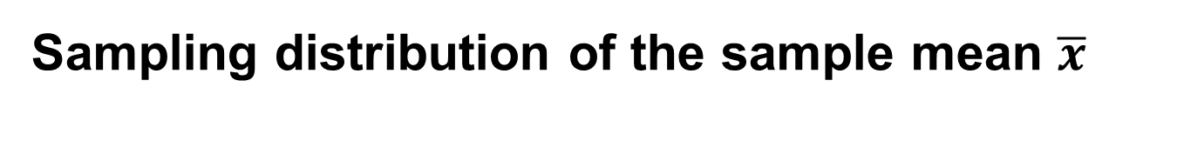
Sampling distribution of the sample mean $\overline{x}$
The value of the sample mean for any sample will depend on the elements included in that sample.
Consequently, the sample mean is a random variable.
Therefore, like other random variable, the sample means possess a probability distribution which is more commonly called the sampling distribution of sample mean.

Slide 22
In general, the probability distribution of a sample statistic is called its sampling distribution.
Sampling distribution is important in statistical inference.
The important characteristics of the sampling distribution of the sample mean are its mean, variance and the form of the distribution.

Slide 23
Example: Suppose we have a hypothetical population of size 3, consisting of three children namely: A is 3 years old, B is 6 years old and C is 9 years old. Construct sampling distribution of the sample mean of size 2 using sampling without replacement and with replacement.
Solution: The mean and variance of the population are 6 and 6, respectively.
If sampling is without replacement we will have ₃C₂ = 3 possible samples: (A, B), (A, C) and (B, C) and their corresponding sample means are (3+6)/2 = 4.5, 6 and 7.5, respectively. Hence the probability distribution (sampling distribution) of the sample mean is:

Slide 24
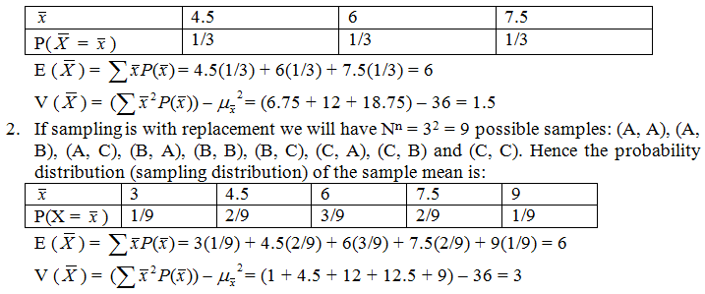

Slide 25
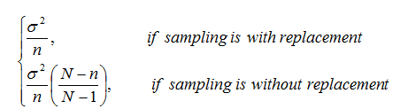
Note:
The mean of the sampling distribution of the sample mean is the same as the population mean irrespective of the sampling procedure.
The variance of the sampling distribution of the sample mean is:

Slide 26
The problem with using sample mean to make inferences about the population mean is that the sample mean will probably differ from the population mean.
This error is measured by the variance of the sampling distribution of the sample mean and is known as the standard error.
The standard error is the average amount of sampling error found because of taking a sample rather than the whole population.
As sample size increases, the standard error decreases.

Slide 27
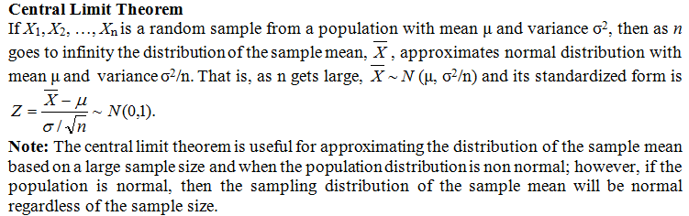

Slide 28
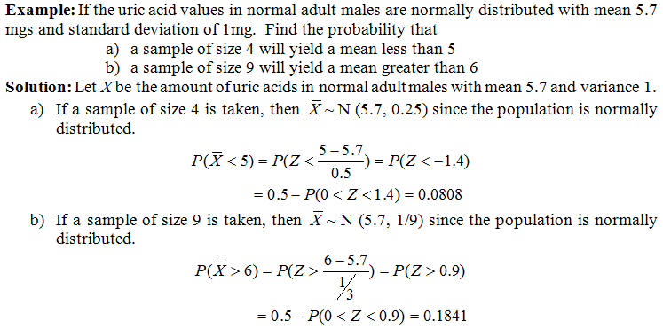

Slide 29
REGRESSION METHODS AND CORRELATION

Slide 30
Introduction
The statistical methods discussed so far are used to analyze the data involving only one variable.
Often an analysis of data concerning two or more variables is needed to look for any statistical relationship or association between them.
Thus, regression and correlation analysis are helpful in ascertaining the probable form of the relationship between variables and the strength of the relationship.

Slide 31
Simple linear regression analysis
Regression analysis is the statistical method that helps to formulate a functional relationship between two or more variables.
It can be used for assessment of association, estimation and prediction.
For instance one might be interested to formulate a statistical model to relate the height of fathers and their sons, blood pressure and age, fertilizer amount and yield, etc.

Slide 32
A simple model to relate dependent (response) variable Y and with only one predictor variable X is to consider a linear relationship.
The first step in regression analysis involving two variables is to construct a scatter plot (diagram) of the observed data.
Scatter diagram is a plot of all ordered pairs (Xi,Yi) on the coordinate plane which is helpful for determining an apparent relationship between two variables.

Slide 33
The simple linear regression of Y on X can be expressed with respect to the population parameters α and β as
where = y-intercept that represents the mean value of the dependent variable Y when the independent variable X is zero; = slope of the regression line that represents the change in the mean of for a unit change in the value of ; = error term

Slide 34

The population parameters α and β can be estimated from sample data using the least square technique. The estimators of α and β are usually denoted by a and b, respectively.
The resulting regression line is:
and the equation is known as the fitted regression line.
The estimated values of y are denoted by . The observed values of are denoted by y

Slide 35


Slide 36
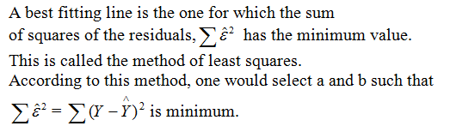

Slide 37
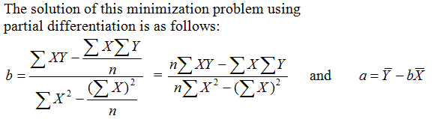

Slide 38
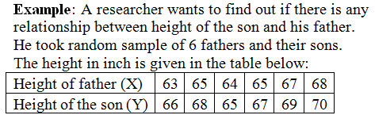

Slide 39
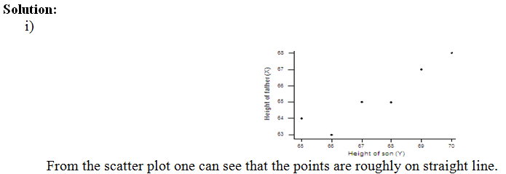

Slide 40
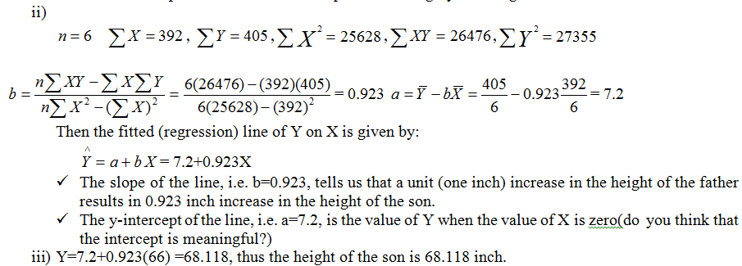

Slide 41
The covariance and the correlation coefficient
Correlation coefficient measures the degree of linear relationship between two variables. The population correlation coefficient is represented by ρ and its estimator is r.
For a set of n pairs of sample values X and Y, Pearson’s correlation coefficient is calculated as the ratio of the covariance of the variables X and Y to the product of the standard deviations of X and Y.

Slide 42
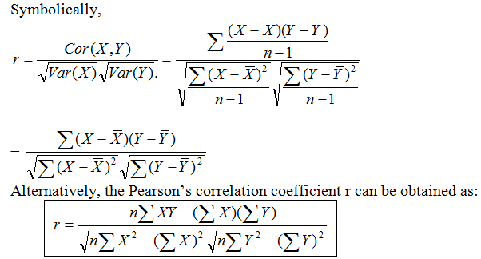

Slide 43
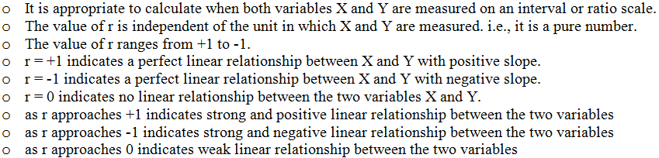
Properties of Pearson’s correlation coefficient r,

Slide 44
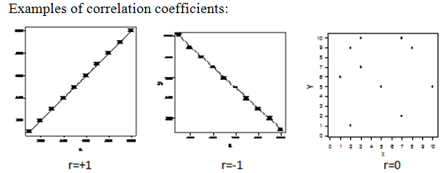

Slide 45
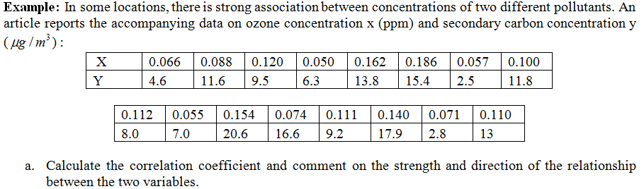

Slide 46
